Slide 1

Bioeconomy-based Agriculture in Latvia
Jelgava, Latvia University of Agriculture, Jelgava palace
December 1. 2016
Mads Randbøll Wolff, CEO, Sustainability 2030
Bioeconomy in a crossroads - what influence the emergent bioeconomies of Europe; growth, climate change and sustainable development.

Slide 2
Agenda
Conclusion
WHY? Why do we talk about bioeconomy, what is bioeconomy the answer for?
Following European examples, what constitutes bioeconomy in Europe? Can we talk about one European model or different European models?
The Danish context and example.
Conclusion

Slide 3
Question:
If bioeconomy is a new solution to known problems, then why do we still talk about business as usual?
Bioeconomy is much more than a quesiton of replaceing fossil resources with biobased resources, and it is much more than a question of technology. Its about society, our economy, social development and not least a more distributed economic and social development! And therefore we need much more than business as usual!

Slide 4
Conclusion:
Bioeconomy is a reaction to a/several problem(s)!
Hence: Bioeconomy can be an answer to both climate change and environmental challenges and to an unbalanced social and economic development. But we need awareness of the challenges
And one size does not fit all!
Diversity!: Invest in place based development and strategies. What is available?
Main question: how can a bioeconomic transformation be a driver for a sustainable local/regional economic and social development?
Its a question of scaling! And not only up-scaling, down-scaling is also needed!

Slide 5
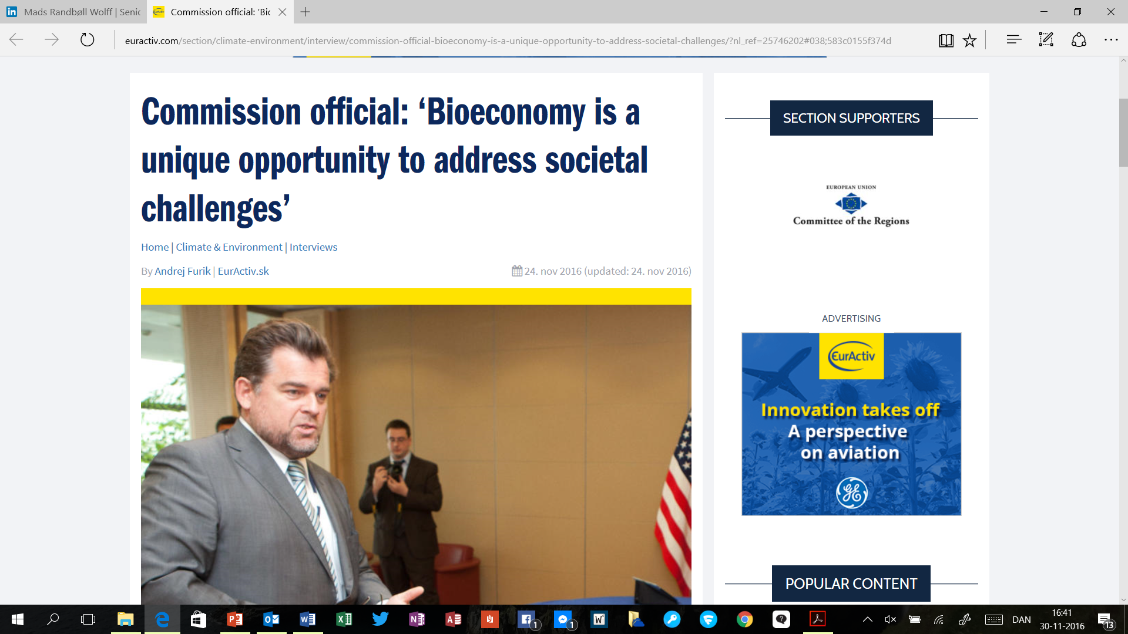
WHY BIOECONOMY?

Slide 6
WHY BIOECONOMY?
Major challenges global and local!
Climate change, environmental issues
Unbalanced social and economic development – a rural development perspective! (OECD: New Rural Paradigm!)

Slide 7
Bioeconomy in a cross roads
- what constitutes bioeconomy in Europe?
Change
Small-scale
Central
Decentral
Large-scale
Substitution

Slide 8
Bioeconomy in Denmark
?
Change
Small-scale
Central
Decentral
Large-scale
Substitution

Slide 9
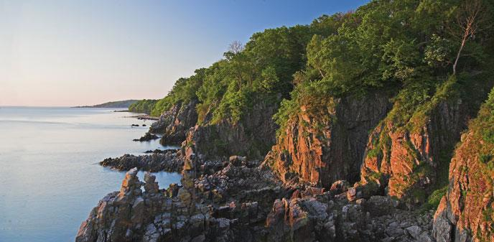


Bioeconomy – the Island of Bornholm:
Two strategic frameworks. 1 Brigth Green Island, 2. LAG strategy
Protein procurement
Zero Co2

Slide 10
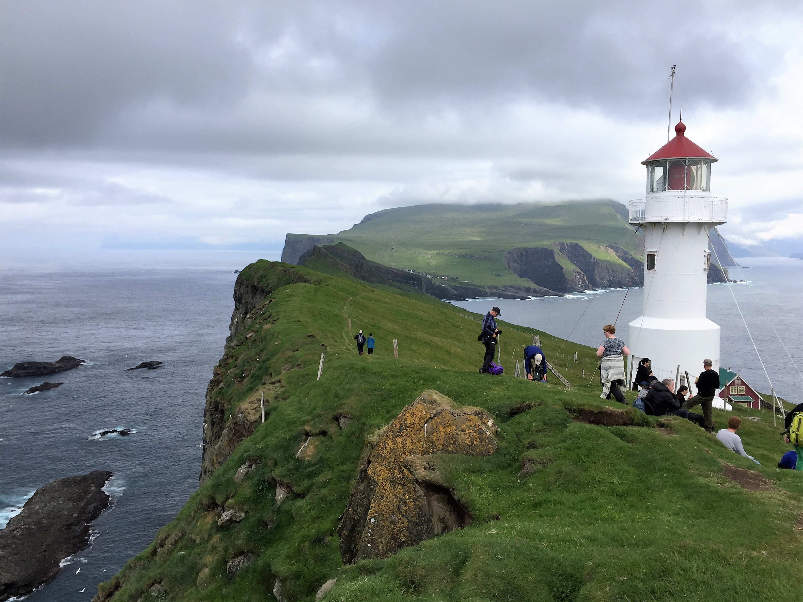
Development on the remote small islands. The case of the Faroese

Slide 11
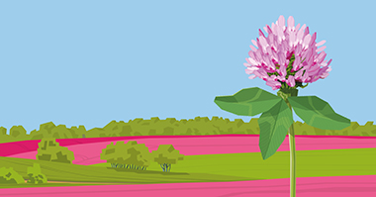
The case of Central Region Denmark
Cascading Bio Resources, Cross-connection Indiustries
Biomass resources are abundant within Central Denmark Region especially with regards to residuals from agricultural production, marine biomass, and organic side streams from households, service and industry.
World leading food and feed companies, such as Arla and Biomar, are located within the region as are many innovative SME’s within the agro and food processing industry.
At the University of Aarhus a number of outstanding and interlinked bio refinery test facilities are available to research and the private industry as a source for collaboration.
Central Denmark Region strongly encourages companies and knowledge institutions to collaborate …
Through development programmes, Central Denmark Region supports SME’s in the development of new bio products….
Bio refinery based on grass – to the benefit of the environment … Protein feed and other high-value products based on grass may …
Bio refinery based on marine biomass – closing the nutrition cycle
Seaweed also has promising potential….
Aquaculture companies within Central Denmark Region are highly experienced ….
Enhanced biogas production from residuals – upgrade, conversion and recirculation

Slide 12
Question:
If bioeconomy is a new solution to known problems, then why do we still talk about business as usual?
Bioeconomy is much more than a quesiton of replaceing fossil resources with biobased resources, and it is much more than a question of technology. Its about society, our economy, social development and not least a more distributed economic and social development! And therefore we need much more than business as usual!

Slide 13
Conclusion:
Bioeconomy is a reaction to a/several problem(s)!
Hence: Bioeconomy can be an answer to both climate change and environmental challenges and to an unbalanced social and economic development. But we need awareness of the challenges
And one size does not fit all!
Diversity!: Invest in place based development and strategies. What is available?
Main question: how can a bioeconomic transformation be a driver for a sustainable local/regional economic and social development?
Its a question of scaling! And not only up-scaling, down-scaling is also needed!

Slide 14
Thank you for your attention!
Mads Randbøll Wolff
Mrwolff@hotmail.com
+45 2167 0233

